Slide 1

GC Accelerators
Accelerating Digital Service Delivery (and Compliance too!)
23 April 2019
GCDOCS#34505958

Slide 2
Content
Purpose:
To provide an overview of the GC Accelerators initiative in support of secure GC Cloud adoption and implementation.
1
Context
2
Initiative Overview
3
Infrastructure as Code
4
Demo
5
Next Steps

Slide 3
Context
Policy
People
Process
Technology
GC Cloud Computing Direction & Standards
Collaborative & Skilled Community
Cloud Security Risk Management, Secure SDLC, etc.
Modern Tooling & Practices

Slide 4

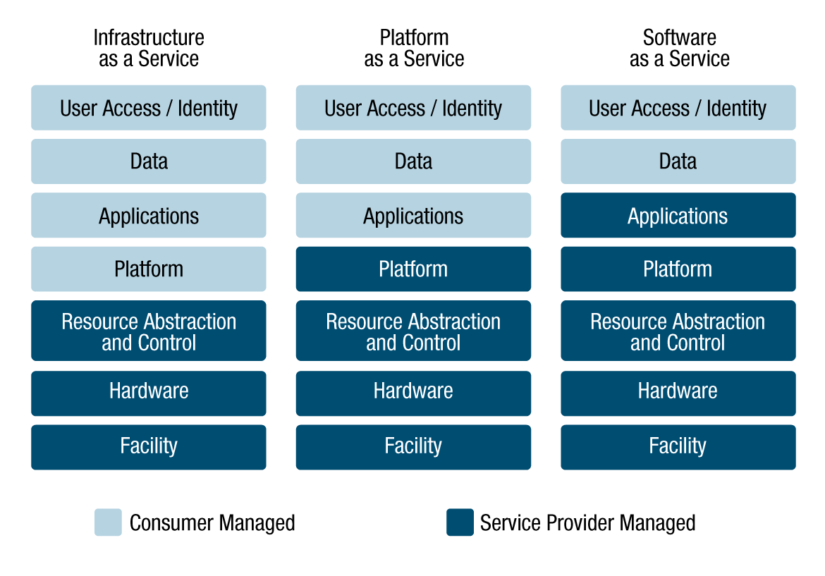
Cloud Security Approach
Cloud Security Risk Management
Shared Responsibility Model
Direction on Secure Use of Commercial Cloud Services: SPIN 2017-01

Slide 5
GC Accelerators Initiative
Objective
To accelerate service delivery and compliance through the use of automation and tools that will enable departments to deploy secure cloud-based environments aligned with GC policies and standards
Key Components
Design Patterns
Templates
Playbooks
Common designs that provide reusable solution to a problem
Templates, scripts, policies to enable automation
Implementation guidance for GC responsibilities
Key Outcomes
AGILITY
VISIBILITY
ASSURANCE

Slide 6
Design Patterns
https://docs.microsoft.com/en-us/azure/governance/blueprints/samples/iso27001-shared/

Slide 7
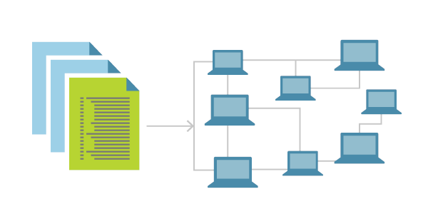

Infrastructure as Code
Version Control System
canada-ca/accelerators_accelerateurs-azure

Slide 8
PSPC Technical Team
John Nephin
Templates, deployments, automation
Application solutions templates for things like CRM and SharePoint, etc.
Yann Gagnon
Subscription Owner and management
RBAC, Policy, Active Directory, RDS, etc.
Bernard
Templates, deployments, automation
Firewall, networking, routing, etc.
Charles Vriesendorp
Security
Firewall
Sean Taylor
Linux/Windows Patching, AV, etc.
Infrastructure runbooks

Slide 9
Our Approach
Goals
What Did We Use?
Results Achieved
Speed
Simplicity
Consistency & Repeatability
Efficiency
Cost savings
Scalable
Automated
Secure
Infrastructure as Code
Azure Resource Manager (ARM) templates
Visual Studio Code
Highly modular ARM templates library
Customizable / extensible deployments modules
One script / click deployment of large scale infrastructure
Working toward PBMM validated solution
Collaboration with all of the GC
Working in the Open
Continuous Integration / Continuous Delivery (CI/CD)
Azure DEVOPS
GitHub
TBS Cloud Project
Architecture documents, coaching
PBMM Controls Mapping

Slide 10
DEMO

Slide 11
Governance

Slide 12
Cloud adoption: a model
Governance
Optimization
Chaos
Awareness
Security
Most companies get stuck here
Notes:
Rick
Presentation Notes:
Slide Objective:
This slide show the five stages of cloud maturity.
Speaker Notes:
Highlight where Microsoft IT is at

Slide 13




Improving security across Azure environments
Azure Security Center
Azure Policy
Log Analytics
Azure Monitor
Faster PBMM Compliance
Protect against threats
Get secure faster

Slide 14

Faster PBMM Compliance
Manage security policy and compliance
Continuously assess security state
Azure Security Center
Optimize and improve security by configuring recommended controls

Slide 15
Faster PBMM Compliance
Assign policies based on built-in and custom definitions
Real time remediation
Real-time policy evaluation and enforcement
Remediation on existing resources
Periodic & on-demand compliance evaluation
Enforcement & Compliance
Remediation

Slide 16
How?

Slide 17
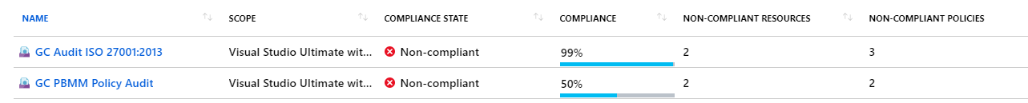
GC Accelerators compliance automation
Azure Policy configuration and assignment to your subscription

Slide 18
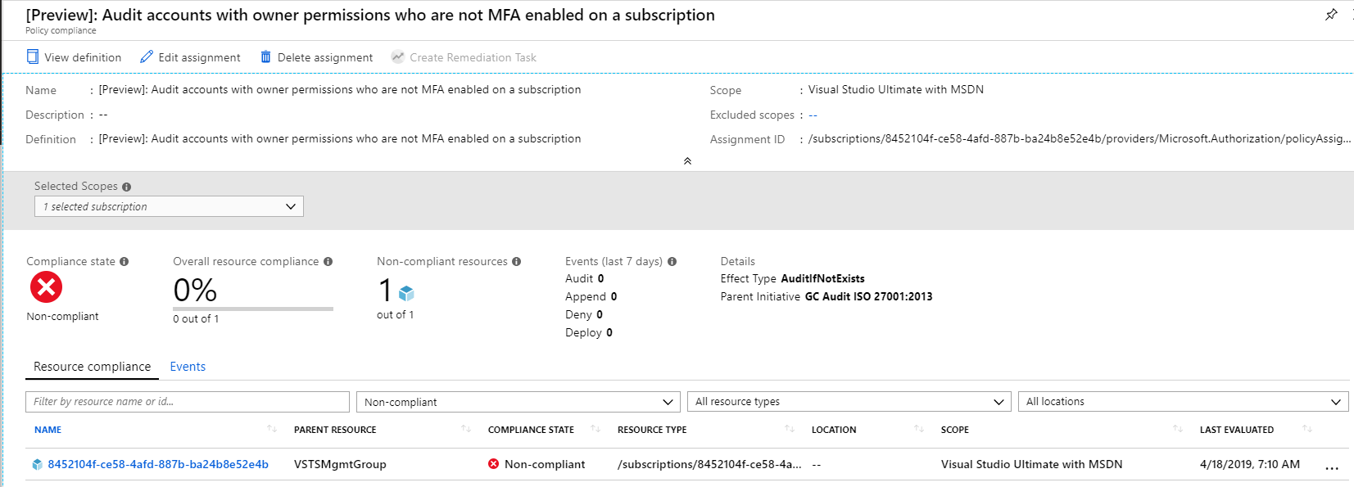
GC Accelerators compliance actions
Audit if x doesn’t exist:

Slide 19
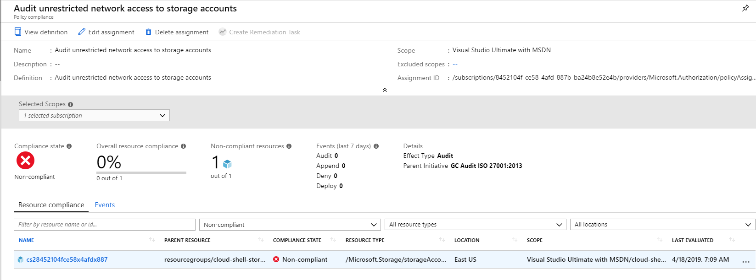
GC Accelerators compliance actions
Audit if control is applied

Slide 20
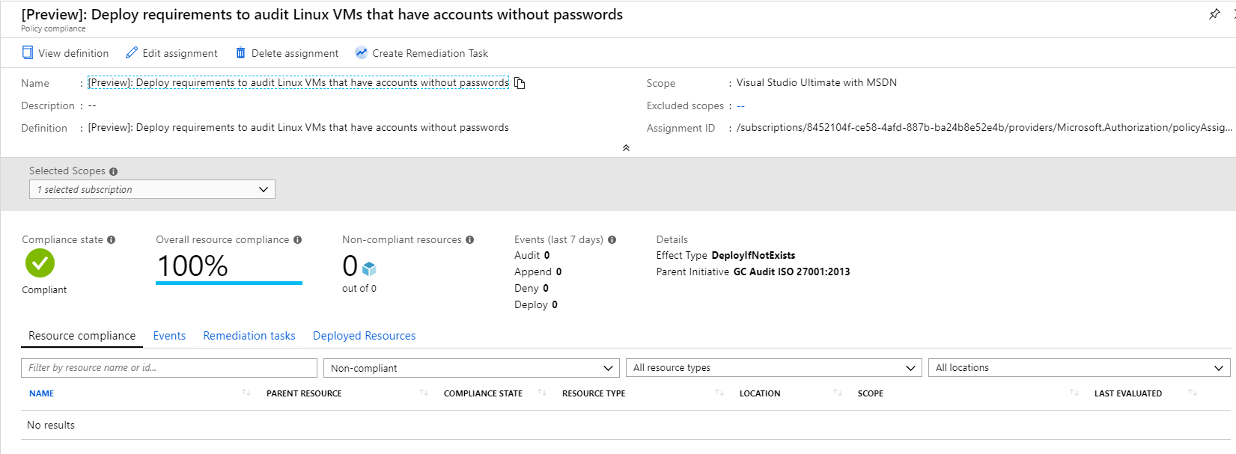
GC Accelerators compliance actions
Deploy if x doesn’t exist: Example: configure audit settings on a Linux VM

Slide 21
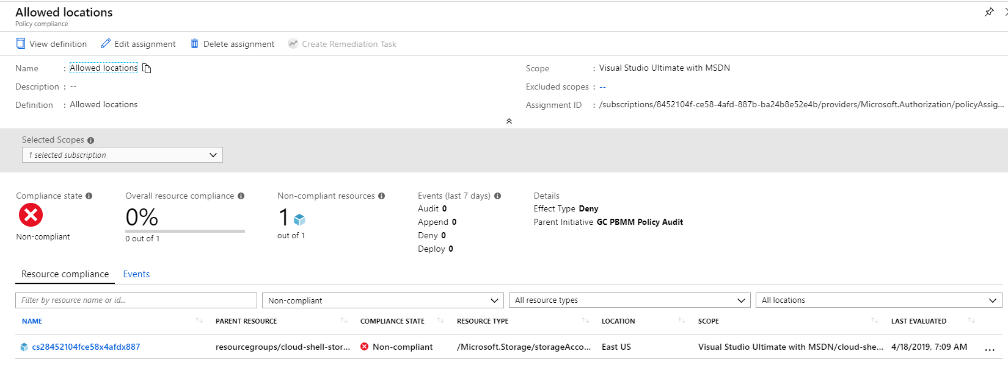
GC Accelerators compliance actions
Deny

Slide 22
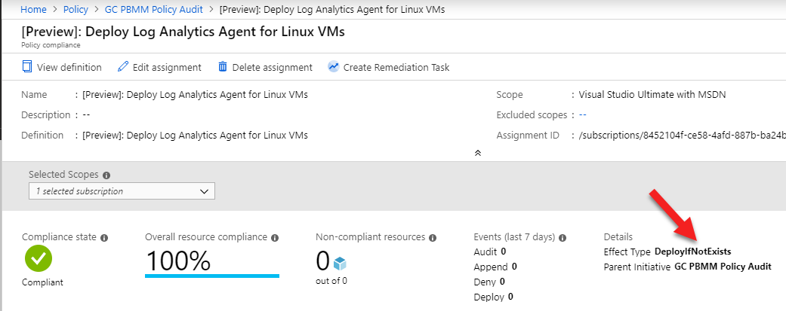
Logging
PBMM requires extensive logging
Azure logs subscriptions events by default (Activity Logs)
GC Accelerators Policy will:
Create a centralised logging workspace (Log Analytics)
Enforce logging for all new and existing VMs (Linux & Windows)
Report logging compliance in Azure Security Center (ASC)
Retain logs for 365 days

Slide 23
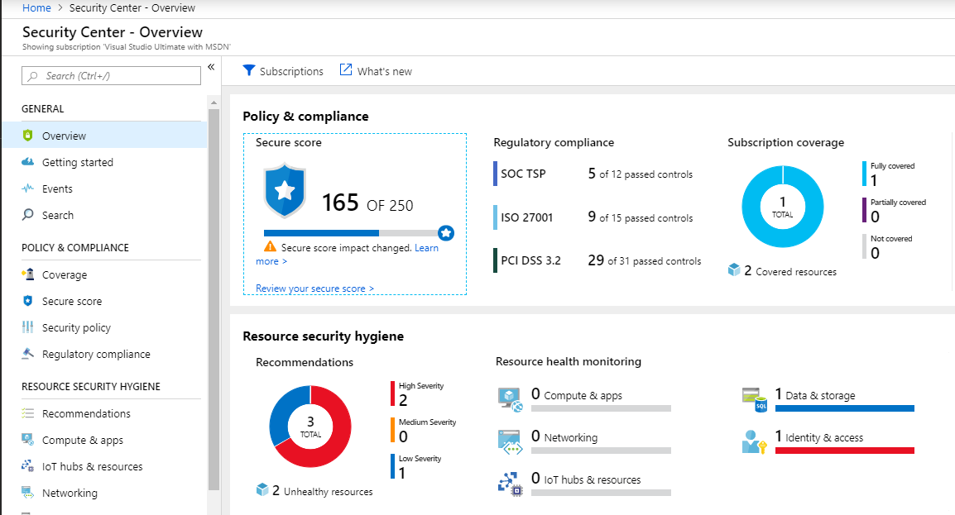
Security Monitoring
Enable Azure recommended subscription security configuration with Azure Security Center (ASC)
Report compliance against recommendations from ASC dashboard

Slide 24
What don’t or can’t we do? (yet)
OS hardening (security baseline)
VM guest security baseline checks (deviation from security baseline)
Deployment using default passwords from GitHub! (PLEASE CHANGE PASSWORDS BEFORE DEPLOYMENT).

Slide 25
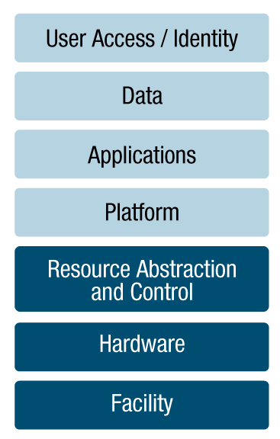


Accelerating ATO
Organizational Policies & Processes
Departmental Controls inherited by Projects
(e.g. Departmental Security Plan)
Use centrally managed common services
Follow tasks in Security Playbooks
Deploy GC Accelerators
Leverage supporting compliance matrices
Complete departmental security assessments
Department
Third party assurance via industry certifications and audit reports
Canadian Centre for Cyber Security (CCCS) CSP IT Security Assessment Program
PSPC Industrial Security Program
Service Provider

Slide 26
How do I get started?
Submit Cloud Request via SSC Cloud Brokering
Clone the Project
Collaborate with your Peers
1
2
3
4
5
Get an Account/ Subscription
Follow the How To Guidance

Slide 27



Where to get help?
Submit an issue
canada-ca/accelerators_accelerateurs-azure
Join the GCmessage channel
#gcaccelerators_gcaccelerateurs
Join the GC Cloud Working Group on GCcollab
https://gccollab.ca/groups/profile/1785962/engc-cloud-working-groupfr
Check out the Cloud Security Initiative page on GCpedia
http://www.gcpedia.gc.ca/wiki/Cloud_Security_Initiative

Slide 28
Next Steps
Community Engagement
Departments can provision and contribute to the templates
Establish GC Cloud Technical Working Group
Workshops
Cloud Service Provider training
Canada School of Public Service (CSPS) Digital Academy
Governance
Approval of design patterns and templates from GC Cloud Governance
Seek endorsement from GC EARB
Evolve the GC Accelerators
Integrate foundational elements such as federation, centralized logging and monitoring
Integrate into CI/CD Pipelines
Integrate templates as part of CI/CD environment

Slide 29

Questions?
Contact us:
TBS, OCIO, Cyber Security
ZZTBSCYBERS@tbs-sct.gc.ca
PSPC
Bernard Maltais
Bernard.Maltais@tpsgc-pwgsc.gc.ca

Slide 30
Annex

Slide 31
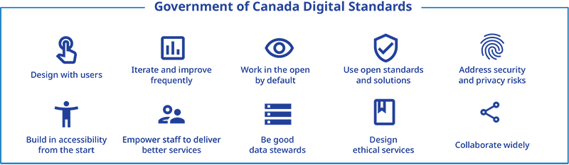
GC Digital Direction
The digital government vision
The Government of Canada is an open and service-oriented organization that operates and delivers programs and services to people and businesses in simple, modern and effective ways that are optimized for digital and available anytime, anywhere and from any device.
Digitally, the Government of Canada must operate as one to benefit all Canadians.
https://www.canada.ca/en/government/system/digital-government/digital-operations-strategic-plan-2018-2022.html
Notes:
Digital standards: principles for making digital government work
In September 2018, the government announced a set of 10 digital standards to set the standard for how government works in the digital era and guide the development of policy, programs and services in government. Prior to being announced by the President of the Treasury Board and Minister of Digital Government, these standards were published in draft as digital principles in the 2017 to 2021 GC IM-IT Strategic Plan and were refined through consultation interdepartmentally and in the open.
These are the expected behaviours for groups designing and implementing policy, programs and services in the digital era. They are intended to guide how the government and public service work on a day-to-day basis:
Design with users: Research with users to understand their needs and the problems we want to solve. Conduct ongoing testing with users to guide design and development.
Iterate and improve frequently: Develop services using agile, iterative and user-centred methods. Continuously improve in response to user needs. Try new things, start small and scale up.
Work in the open by default: Share evidence, research and decision-making openly. Make all non-sensitive data, information, and new code developed in delivery of services open to the outside world for sharing and reuse under an open licence.
Use open standards and solutions: Leverage open standards and embrace leading practices, including the use of open source software where appropriate. Design for services and platforms that are seamless for Canadians to use, no matter what device or channel they are using.
Address security and privacy risks: Take a balanced approach to managing risk by implementing appropriate privacy and security measures. Make security measures frictionless so that they do not place a burden on users.
Build in accessibility from the start: Services should meet or exceed accessibility standards. Users with distinct needs should be engaged from the outset to ensure what is delivered will work for everyone.
Empower staff to deliver better services: Make sure that staff have access to the tools, training and technologies they need. Empower the team to make decisions throughout the design, building and operation of the service.
Be good data stewards: Collect data from users only once and reuse wherever possible. Ensure that data is collected and held in a secure way so that it can easily be reused by others to provide services.
Design ethical services: Make sure that everyone receives fair treatment. Comply with ethical guidelines in the design and use of systems that automate decision-making (such as the use of artificial intelligence).
Collaborate widely: Create multidisciplinary teams with the range of skills needed to deliver a common goal. Share and collaborate in the open. Identify and create partnerships that help deliver value to users.

Slide 32
References
TB Policies & Standards
Policy on Management of Information Technology
Policy on Government Security
Direction for Electronic Data Residency, ITPIN No: 2017-02
Direction on the Secure Use of Commercial Cloud Services: Security Policy Implementation Notice (SPIN)
Guidance
Government of Canada Security Control Profile for Cloud-Based GC IT Services
Government of Canada Cloud Security Risk Management Approach and Procedures
CSE ITSG-22 Baseline Security Requirements for Network Security Zones in the Government of Canada
CSE ITSG-38 Network Security Zoning - Design Considerations for Placement of Services within Zones
CSE ITSP.30.031 V2 User Authentication Guidance for Information Technology Systems
CSE ITSP.40.062 Guidance on Securely Configuring Network Protocols

